Slide 1
[MAT3D] by Matrix Masters
JACOB SCHWARTZ
ZOE TACDERAS ALFREDO RIVERO
ABRHAM CARDENAS TIM TIANYI
JULY 26TH, 2018

Slide 2
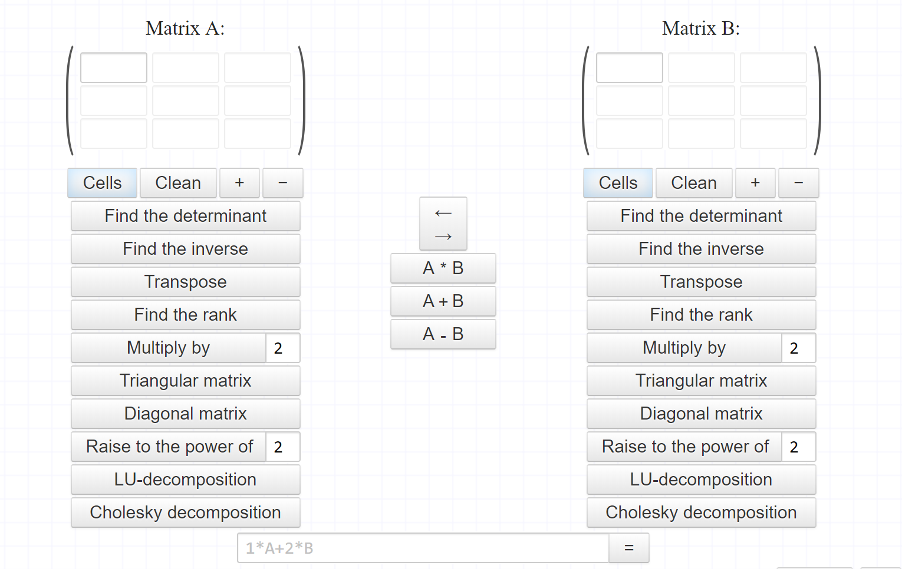
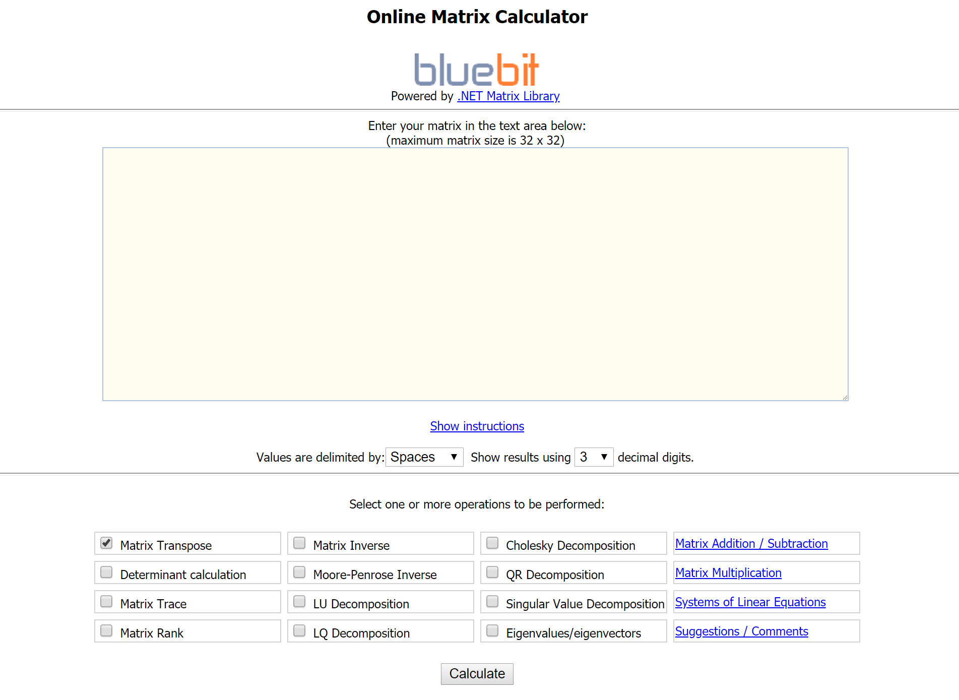
Introduction: A better, different matrix calculator
EXAMPLE A: THE (VARIABLED) INSPIRATION
Dedicated online matrix calculators:
Do not not allow complex calculations
Are not user friendly
Are open to improvement
There is no educational tool for experimentation with matrix transformations.
[MAT3D] is a matrix calculator we envisioned to:
NOT have the same caveats as other calculators
Serve as the missing matrix transformation experimentation tool
EXAMPLE B: THE SIMPLE CAVEAT

Slide 3
OUR GOALS: what we
DiD ACHEIVE
OUR GOALS: what we
DiDN’T ACHEIVE
Be able to define and compute matrices through robust calculations.
Have a user interface which facilitates matrix computation.
Be able to apply a defined matrix to a externally loaded model.
Be able to switch the matrix definition area with a 3D viewing area using a button
Be able to define scalar values through an easily accessible part of the website.
Be able to apply multiple defined matrices to the 3D model in the viewing area.

Slide 4
OUR challenges: WEB Development is different
OUR Achievements: We Pulled through
DEVELOPMENT SPECIFIC
Limited experience with web development
PROJECT SPECFIC
Designing a dynamic, user friendly UI
Being able to understand mathematical expressions
External functionality within the 3D viewing area
DEVELOPMENT SPECIFIC
Able to learn and expand our web development skill set
Applied agile development practices for the first time
PROJECT SPECIFC
Developed an intuitive user interface
Developed an usable mathematical expression parser
Developed a 3D viewing area with external functionality
Applied agile development practices for the first time

Slide 5
[MAT3D] by Matrix Masters
LIVE DEMO

Slide 6
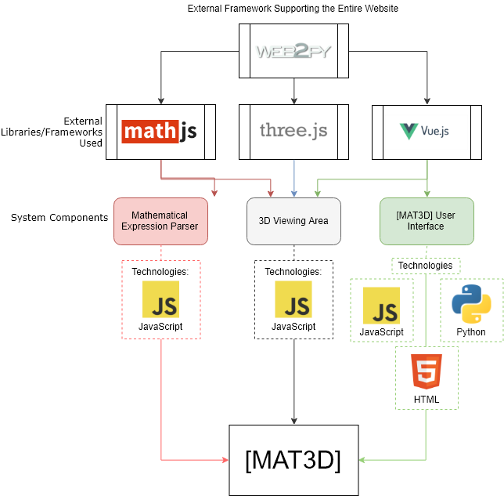
System overview
LANGUAGES:
JavaScript
HTML
Python
EXTERNAL LIBRARIES
Math.js (Math Library)
Three.js (Graphics Library)
FRAMEWORKS
Web2Py (Web Hosting)
Vue.js (User Interface)

Slide 7
PROJECT MANAGEMENT: HOW IT was DONE
Agile Software Development

